Slide 1
Doctor Appointment System
By:
Nishan Mahat
&
Dipesh Kumar Shrestha

Slide 2
Introduction
A system that allows patients to easily book their appointment.
It provides a user-friendly interface for all users.
It saves time and effort for both users and healthcare staff.
It requires no formal knowledge.

Slide 3
Problem Statement
User often experience longer waiting times when booking doctor appointments.
Health care provider often face difficulties when physically booking appointments especially when there is large number of users.
Health care provider face difficulties while maintaining large number of users data.

Slide 4
Objectives
To provide a user-friendly online appointment booking system that is easy to use and available for all user.
To provide an efficient system for health care providers to manage doctor and patient detail as well as appointments.

Slide 5
SCOPE & LIMITATIONS
Scope:
Users can view available doctor and schedule appointments.
Users can view their appointment information within the booking section.
Limitations:
User cannot chat or have video calls with doctors.
This system does not have health package feature for users.

Slide 6
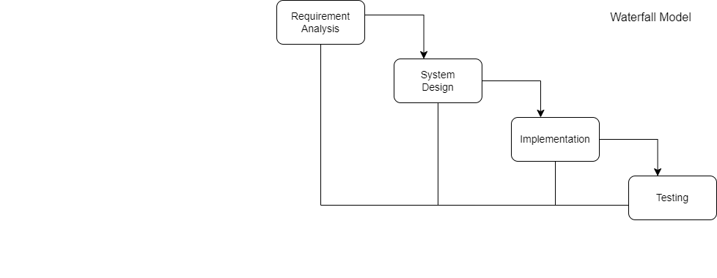
METHODOLOGY
Figure: Waterfall model
Our project has specific documentation, fixed requirements and unlikely to change significantly. So, we are using waterfall model.

Slide 7
Requirement Collection
Functional Requirement:
User will be able to send request to the doctor for appointment.
User will be able to see the list of all doctor as per their specialty.
Doctor can accept/reject appointment.
Doctor will be able to see list of all appointment.
Admin can manage users, doctors.

Slide 8
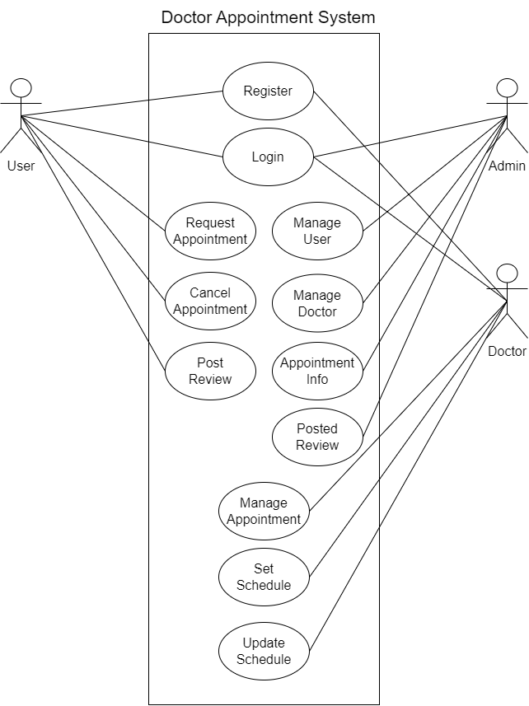
USECASE Diagram

Slide 9
Non-Functional Requirement:
Security: This system will be secure as the user’s information will not be visible to other users. This system will maintain privacy.
Reliability: This system will be reliable for both the users and doctors.
Usability: This system will be easy to use and navigate, with user-friendly interface.

Slide 10
Feasibility Study
Technical Feasibility :
This system uses existing technologies, software and hardware so there is technological hurdle to build this system.
Operational Feasibility :
This system is easy to use because it's designed with simple technology, making it user-friendly for everyone.
Schedule Feasibility:
The system is completed within scheduled time and do not exceed the scheduled time.

Slide 11
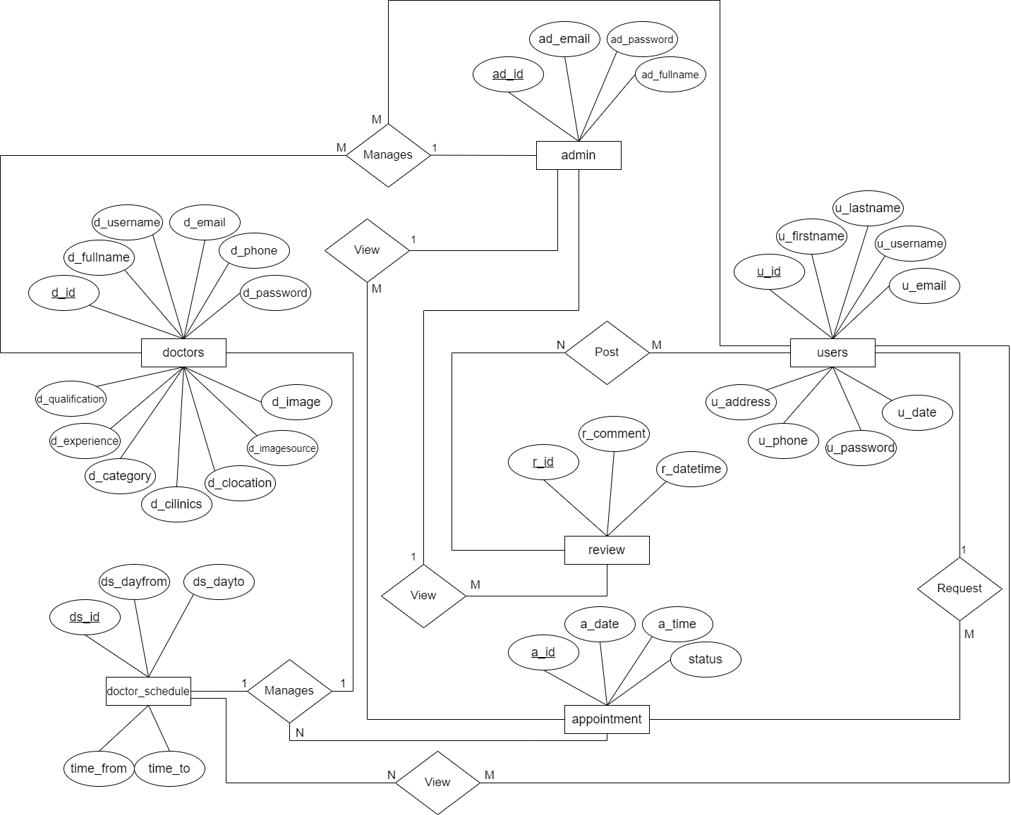
ER-Diagram
Figure: ER-diagram of Doctor Appointment System

Slide 12
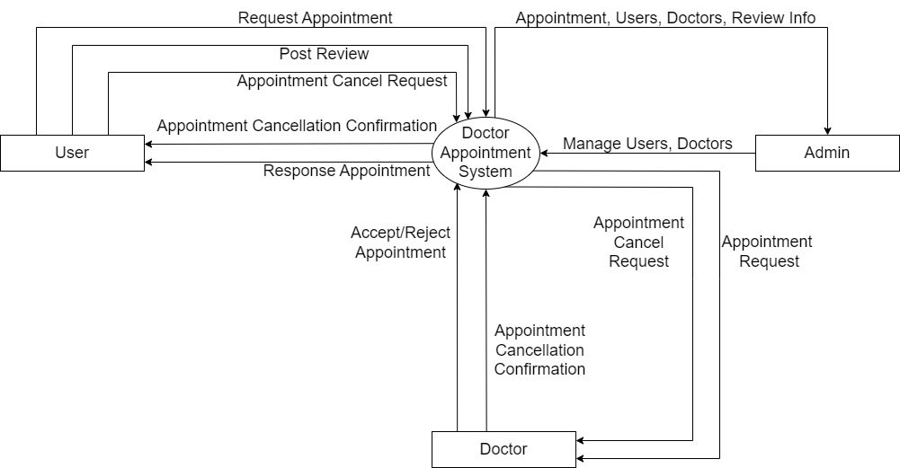
High Level Design of System
Data Flow Diagram
Figure: DFD level 0 of Doctor Appointment System

Slide 13
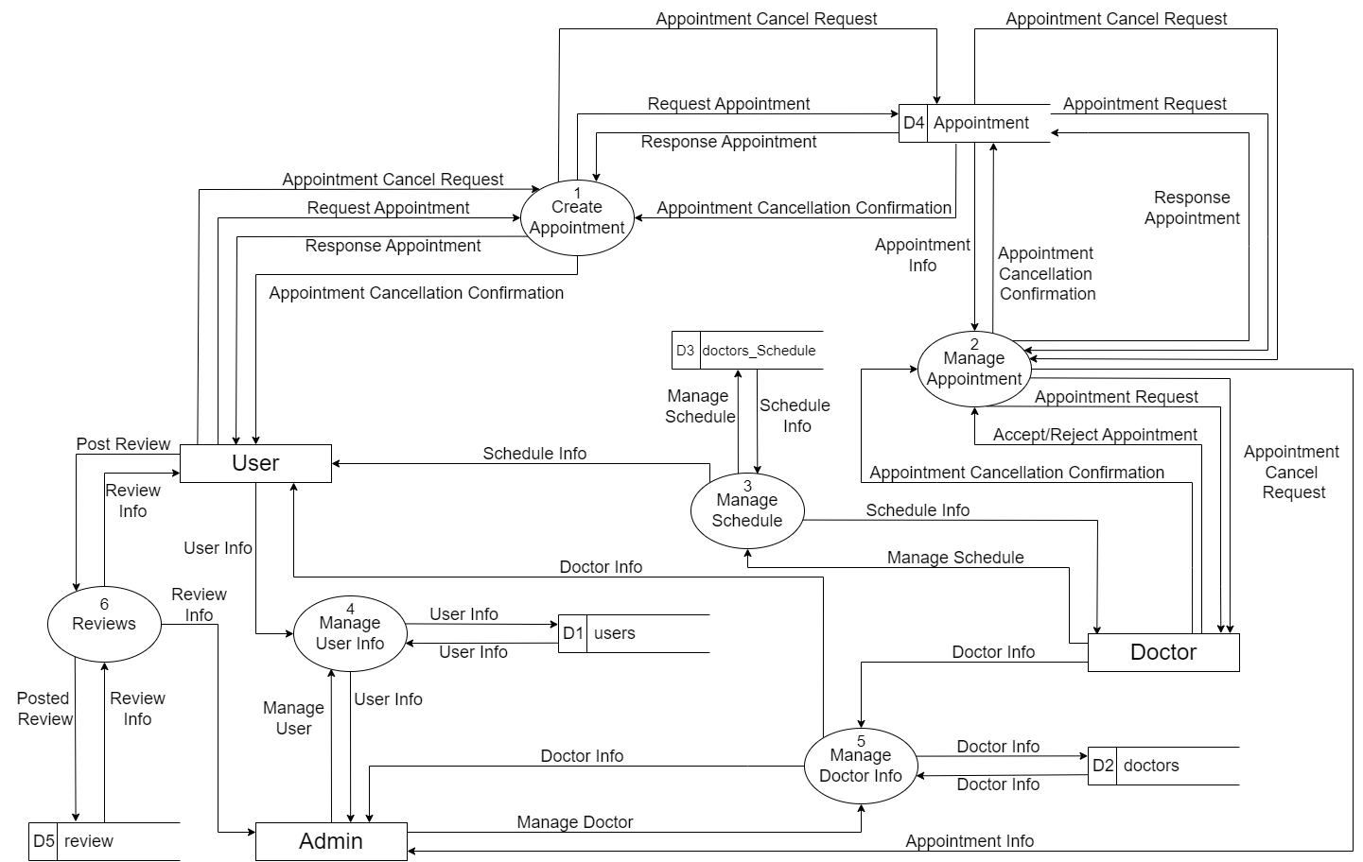
Figure: DFD level 1 of Doctor Appointment System

Slide 14
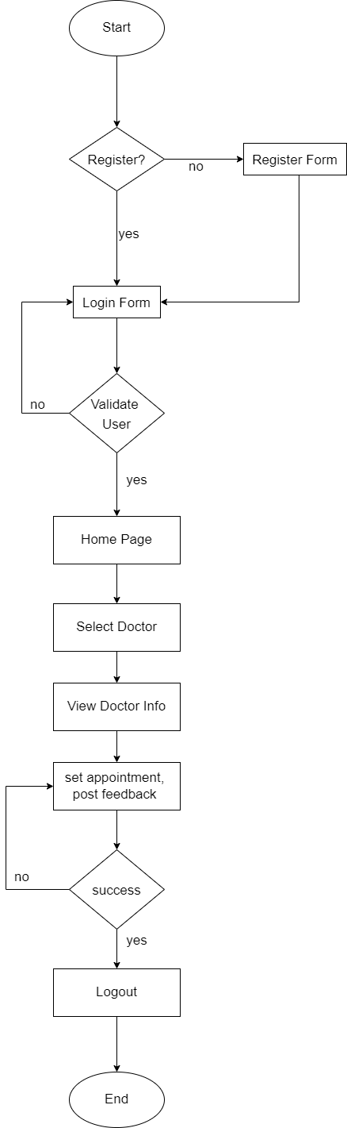
FLOW CHART
Flowchart of Doctor Appointment System for user

Slide 15
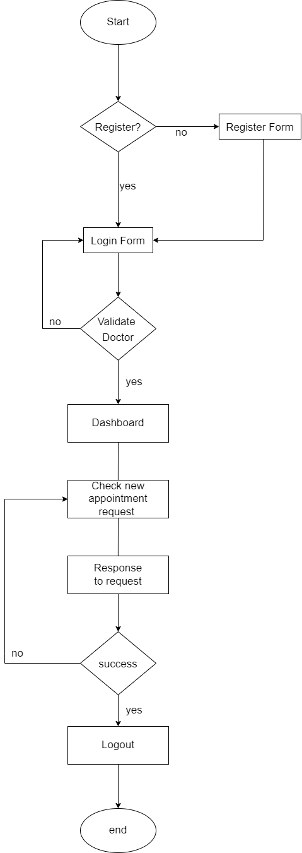
Flowchart of Doctor Appointment System for doctor

Slide 16
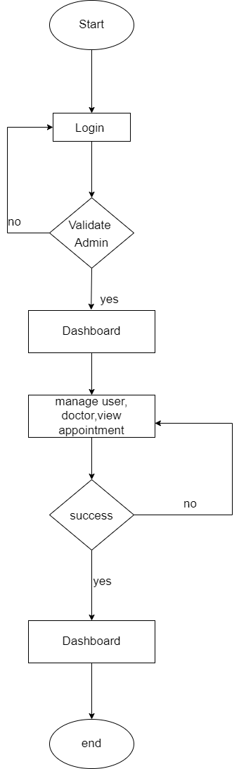
Flowchart of Doctor Appointment System for admin

Slide 17
THANK YOU

